Slide 1
Locomotion Skills for Simulated Quadrupeds
Tanmay Randhavane, Alok Yadav

Slide 2
CS 775 Open Project
“Locomotion Skills for Simulated Quadrupeds “ by S.Coros, A.Karpathy, B.Jones, L.Reveret, M.V.de Panne. Published in “ACM SIGGRAPH 2011”.

Slide 3
The Problem

Slide 4
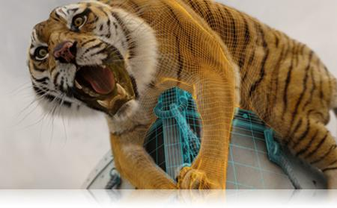
The Problem
Quadrupeds (four-legged animals) are integral part of our lives.
So, it is not surprising that they make appearance in our movies and games. Robotics also presents the need to model their motions.
Life of Pi - Credits - © 2014 CGTantra.com

Slide 5
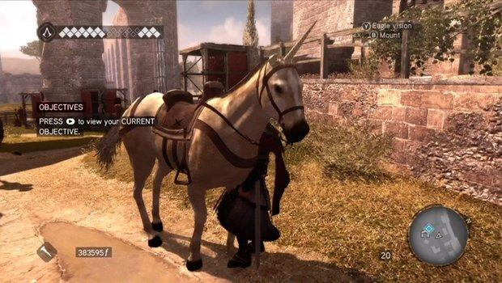
The Problem
Since, the quadrupeds appear frequently in movies and games, there is a requirement to model their basic gaits and motions.
So, in this paper the authors have tried to solve this particular problem.
They propose a method to model the basic gaits of the quadrupeds including walk, trot, pace, canter, gallop and also to model actions like sitting down, lying down, standing up, getting up, leaps and jumps.
Assissin’s creed - http://www.gamesradar.com/

Slide 6
Approach

Slide 7
Controller based approach
The solution proposed in this paper, is based on a controller based approach to create robust quadruped motions.
The controller has some parameters which are initialized for each gait and then are optimized using motion capture data to model the particular styles of gaits in the quadruped.
The abstract flexible spine and leg frame model provide a better control on the gaits and gait parameters.

Slide 8
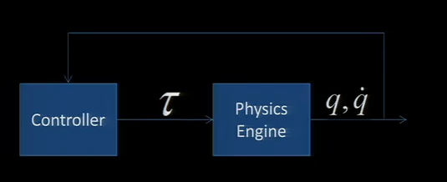
Abstract View
Credits :-“Locomotion Skills for Simulated Quadrupeds “ by S.Coros, A.Karpathy, B.Jones, L.Reveret, M.V.de Panne. Published in “ACM SIGGRAPH 2011”.

Slide 9
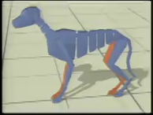
Character Details
Leg Frames
Flexible Spine
Credits :-“Locomotion Skills for Simulated Quadrupeds “ by S.Coros, A.Karpathy, B.Jones, L.Reveret, M.V.de Panne. Published in “ACM SIGGRAPH 2011”.

Slide 10
The Controller

Slide 11
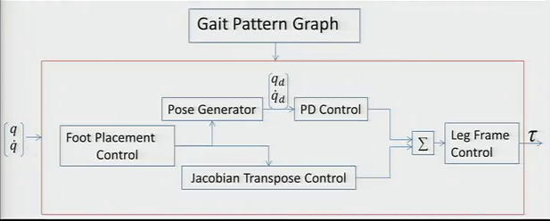
Overview of the Controller
Credits :-“Locomotion Skills for Simulated Quadrupeds “ by S.Coros, A.Karpathy, B.Jones, L.Reveret, M.V.de Panne. Published in “ACM SIGGRAPH 2011”.

Slide 12
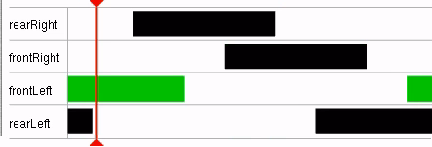
Gait Graphs
T
The timing and relative phasing of legs in a gait is dictated by a gait graph.
Swing
Stance
Gait graph is defined for a stride period T.
We define swing phase and stance phase for all four legs in the gait graph.
Gait graph for walk
Credits :-“Locomotion Skills for Simulated Quadrupeds “ by S.Coros, A.Karpathy, B.Jones, L.Reveret, M.V.de Panne. Published in “ACM SIGGRAPH 2011”.

Slide 13
Overview of the Controller
Credits :-“Locomotion Skills for Simulated Quadrupeds “ by S.Coros, A.Karpathy, B.Jones, L.Reveret, M.V.de Panne. Published in “ACM SIGGRAPH 2011”.

Slide 14



Foot Placement Control
The foot placement control part finds the desired foot placement location for the swing legs.
The location of the foot placement is calculated as follows:
here,
= the default stepping location relative to the leg frame
= the scaling factor

Slide 15
Foot Placement Control
The height trajectory of a foot as a function of swing phase is initially given and then tuned during optimization.
At any point during the swing phase, the position of the foot in the ground plane is given by linearly interpolating between the previous toe-off position and the calculated strike down position.
Using the height trajectory and the position calculated in the ground plane, we get the foot location at any time step.

Slide 16
Overview of the Controller
Credits :-“Locomotion Skills for Simulated Quadrupeds “ by S.Coros, A.Karpathy, B.Jones, L.Reveret, M.V.de Panne. Published in “ACM SIGGRAPH 2011”.

Slide 17
Pose Generator
After getting the target position of the foot, the orientation of joints is determined by the pose generator.
We use inverse kinematics (for leg joints), predefined trajectories (for head and neck) and interpolated leg-frame orientations (for spine) to get the target joint angles.
Every joint has a proportional-derivative (PD) controller attached to it, which when given a desired orientation and current orientation returns the required torque to be applied at the joint. This torque is the first source of computed torque.

Slide 18
Overview of the Controller
Credits :-“Locomotion Skills for Simulated Quadrupeds “ by S.Coros, A.Karpathy, B.Jones, L.Reveret, M.V.de Panne. Published in “ACM SIGGRAPH 2011”.

Slide 19
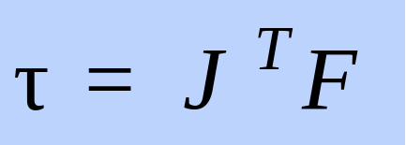
Virtual Forces
Virtual forces (e.g. gravity) provide the second source of computed torques.
The torque to be applied for a virtual force is calculated using Jacobian Transpose Control by following equation -
These two torques are then summed up and sent to a forward dynamics simulation engine.

Slide 20
Overview of the Controller
Credits :-“Locomotion Skills for Simulated Quadrupeds “ by S.Coros, A.Karpathy, B.Jones, L.Reveret, M.V.de Panne. Published in “ACM SIGGRAPH 2011”.

Slide 21

The Leg Frame Control
The net torque on a leg frame must be zero to avoid the quadruped from toppling.
The internal forces should provide all the torque on a leg frame. The leg frame control module achieves this by disabling active control of the stance leg. The torque on the stance leg is then calculated as -

Slide 22
Physics Engine
The torques thus obtained from the controller are then provided to the forward dynamics engine.
The forward dynamics engine then gives the motion for the next time step.

Slide 23
Optimization

Slide 24
Parameter Optimization
The default initialization of the controller parameters gives only a basic version of the gaits. Using optimization, particular styles of gaits can be modelled.
The gaits can be optimized by matching the gaits of the simulated quadruped to the gaits of a filmed dog using motion capture data.

Slide 25
Parameter Optimization
The optimization is done by minimizing an objective function using a greedy stochastic local optimization algorithm.
The optimization function depends on the differences between desired position of the markers, desired heading, desired velocity and head accelerations.

Slide 26
Gait Selection
The gaits of the quadruped are developed to work for a specific range of speeds.
The gait and gait parameter are selected according to the desired speed for the quadruped in the next time step.

Slide 27
Gait Transition
The desired speed for each time step is computed such that it is always in a range of 0.5 m/s from the current speed.
The gait and gait parameters of the desired speed are selected and the transition between the two gaits is achieved by linear interpolation between the two gait parameters.

Slide 28
Other Gaits

Slide 29
Parameterized Leaps
A leap consists of 3 stages:
loading
take-off
airborne
In the loading stage, the quadruped is set in the jumping stance.
In take-off stage, virtual forces are applied to propel the body into the air.
In the airborne stage, when the velocity of center of mass becomes negative, the body is prepared for landing.

Slide 30
Sitting
Sitting consists of two phases.
In the first phase, the body is prepared for sitting, for example, by moving the back legs outward.
In the second phase, the hip height is decreased until the model is resting on its buttocks.

Slide 31
Lying Down
Lying down also consists of two phases.
First phase of lying down is identical to the sitting module.
In the second phase, shoulders are lowered until the quadruped is lying down.

Slide 32
Standing Up
Standing up from sitting involves stepping forward with the front legs while increasing the hip height.
Standing up from lying down position involves increasing the hip and shoulder height without stepping. If the standing position is unstable, balance is restored by invoking the walking module with zero speed for one or two cycles

Slide 33
Getting Up
Getting up module models the motion of getting up from sideways lying position.
It involves two phases. In the first phase, the spine is twisted to bring roll the quadruped onto its front feet.
Once the shoulder frame is vertical and the front feet are securely planted the quadruped applies forward vertical forces to the shoulder and hip frames.

Slide 34
Results

Slide 35
Results
The system is robust against perturbation forces.
Variable terrain in the form of series of low steps can be successfully traversed by the quadruped.
The model is able to leap up onto platforms, leap over barriers and leap at specific objects.
The results can be best observed from the video - https://www.youtube.com/watch?v=dRthdBr46cs

Slide 36
Future Work

Slide 37
Future Work
The work performed is tested only for dog. It needs to be modelled for quadrupeds of different proportions such as elephants.
Certain gaits not realistic if they are not optimized by using motion capture data. If motion capture data is not available, for example, while modelling non-existent animals, the method may need modification.
The capabilities of the model are limited to few gaits only. The model, for example, cannot land on paws like a cat.

Slide 38
Questions?

Slide 39
Thank you.

